Slide 1
Integrating Kubernetes and Azure
Sam Cogan
Solution Architect, Willis Towers Watson & Microsoft MVP
samcogan.com
@samcogan

Slide 2










Slide 3
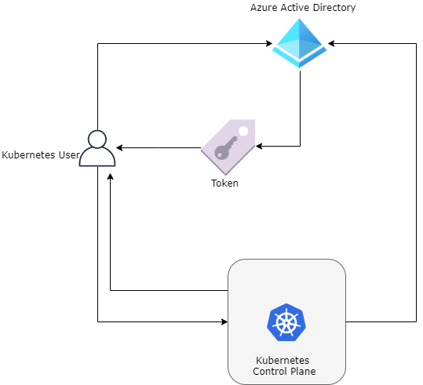
Azure AD Integration

Slide 4
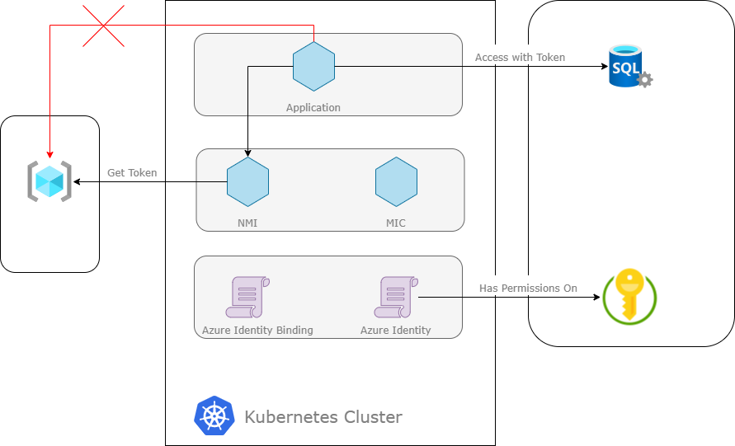
Pod Identity

Slide 5
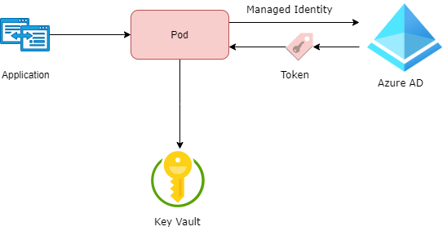
Key Vault
Key Vault Flex Volume - https://github.com/Azure/kubernetes-keyvault-flexvol
Key Vault to Kubernetes - https://github.com/SparebankenVest/azure-key-vault-to-kubernetes

Slide 6
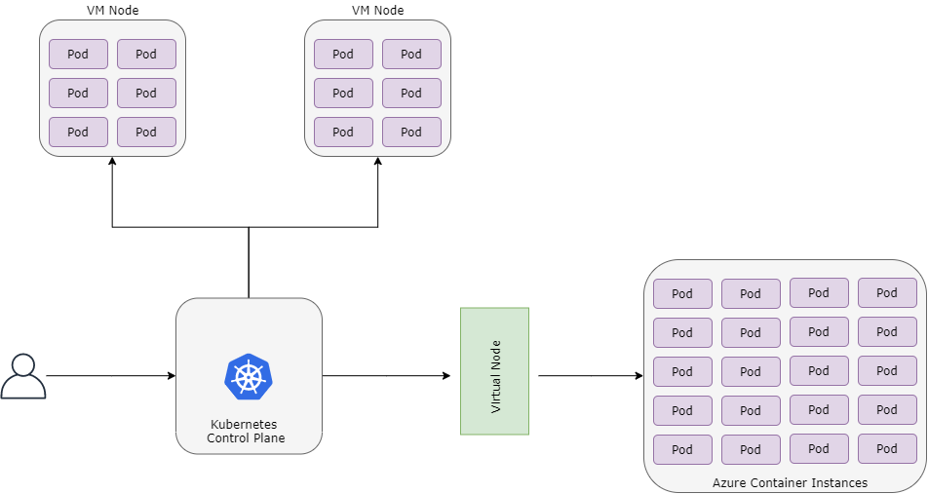
Virtual Node

Slide 7


Monitoring & Scaling
Promitor - https://promitor.io/
Keda - https://github.com/kedacore/keda

Slide 8
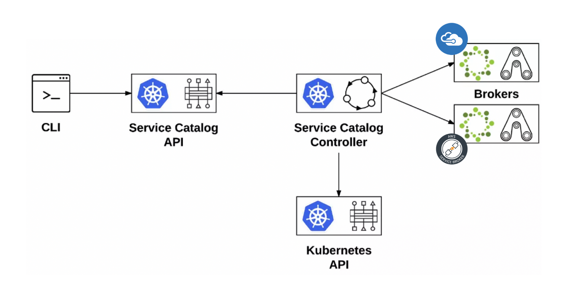
Open Service Broker for Azure

Slide 9
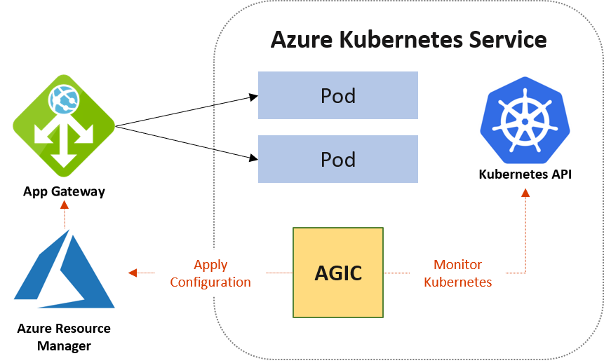
App Gateway

Slide 10
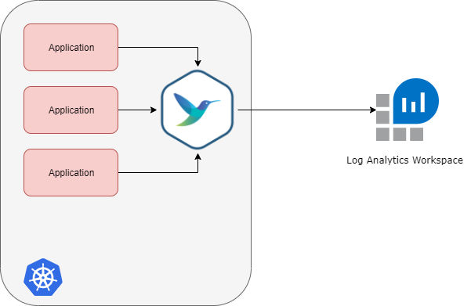
Fluent Bit Logging

Slide 11




About Me
Sam Cogan
Solution Architect – Willis Towers Watson
Microsoft Azure MVP
samcogan.com
@samcogan
sam-cogan

